Slide 1



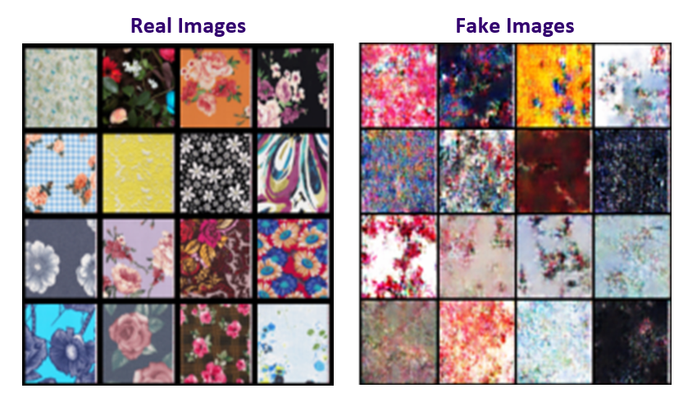
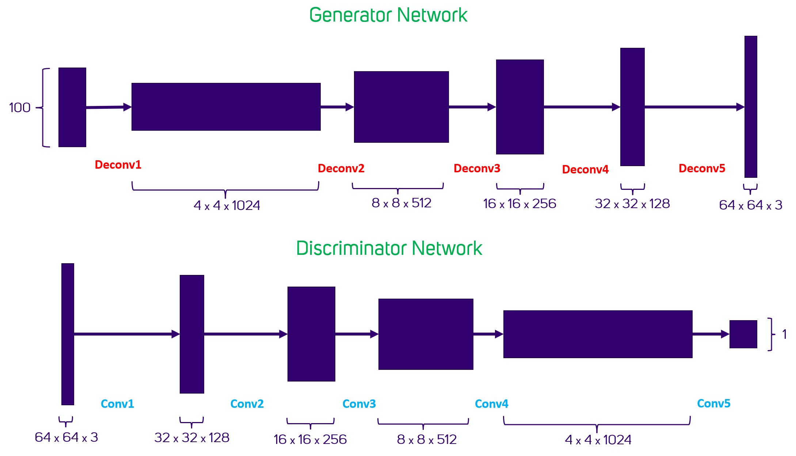
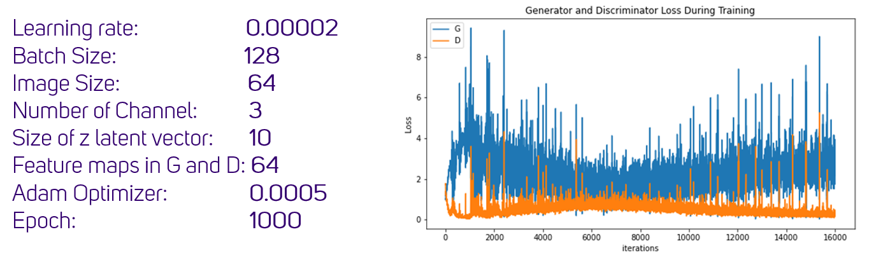
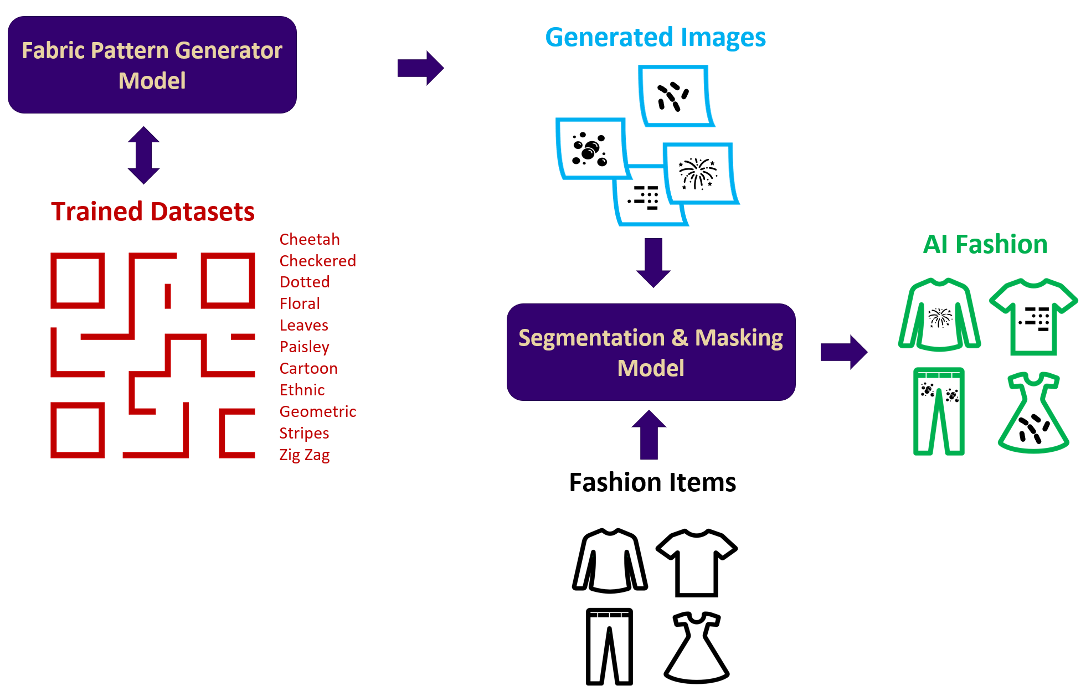
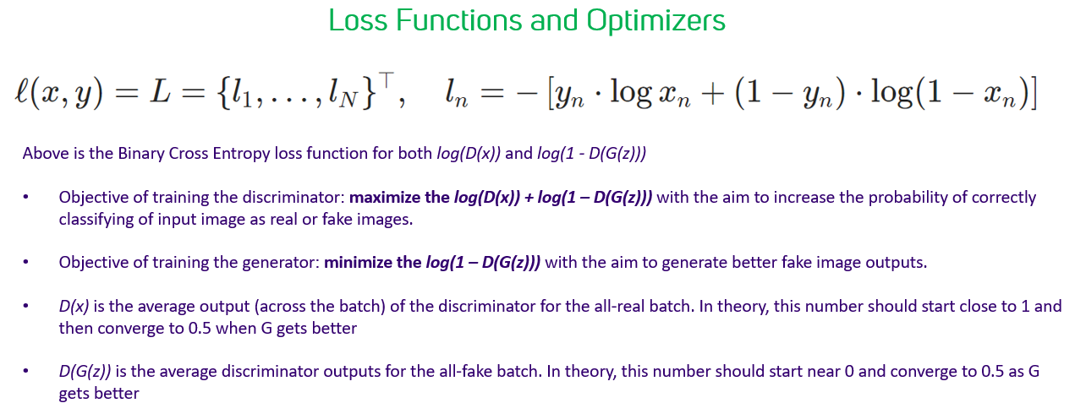
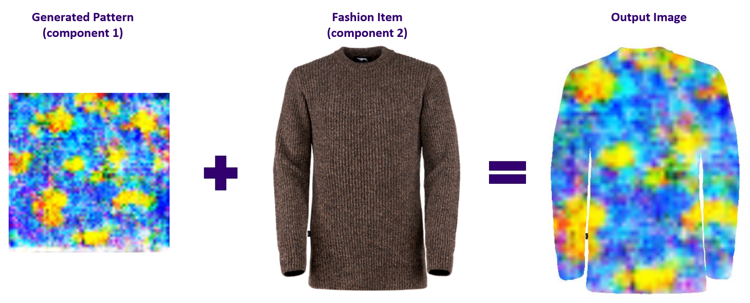
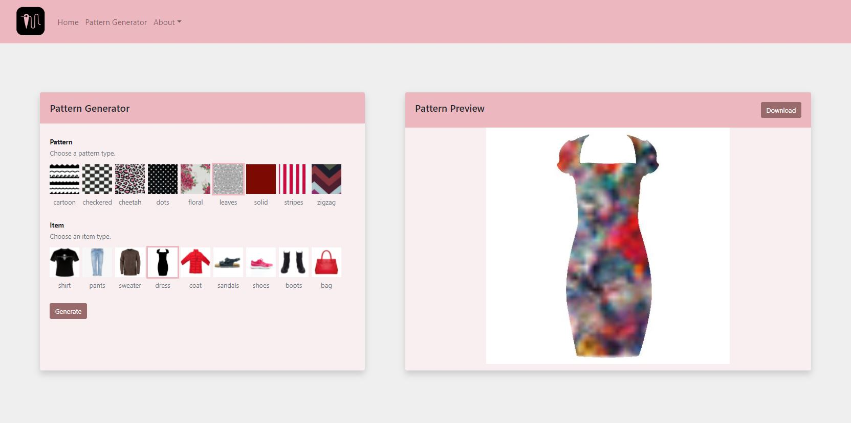
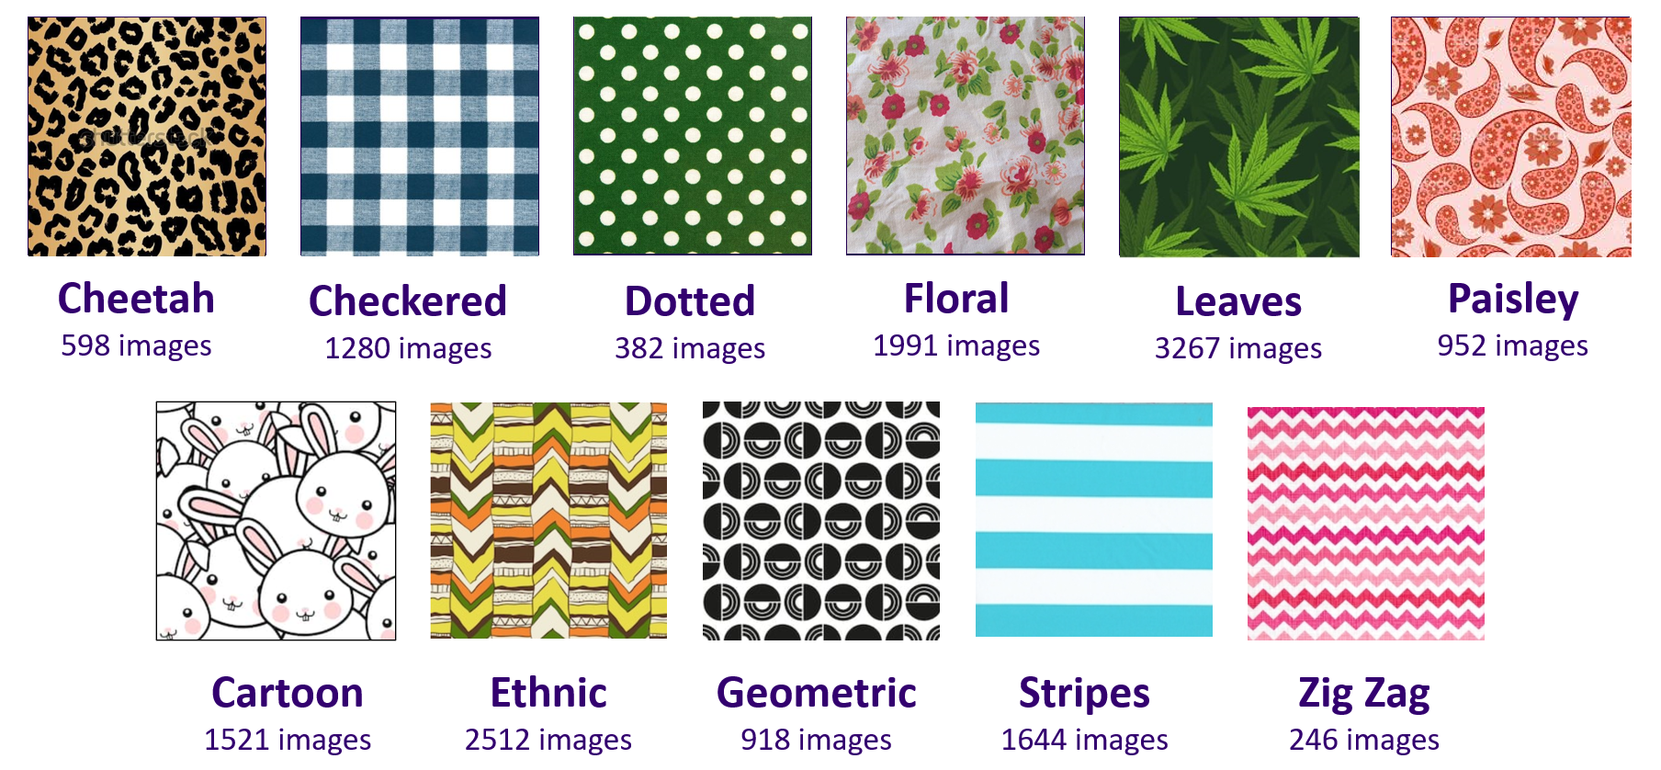
AI FASHION
UW Master of Science in Data Science | 2022 Capstone Project
TEAM: Aaliyah Hänni, Dwight Sablan, Liem Luong, Vanessa Hsu
SPONSOR: Tatiana Teppoeva | Microsoft Sr. Data & Applied Scientist
INTRODUCTION
MODEL
RESULTS
CONCLUSIONS
Art and data science, the two fields gain more popularity in recent years. The application between art and AI are the inspiration for people to produce new pieces of art with more accessible to the broader audience.
In the fashion industry there is a constant demand for new and interesting design patterns, which can often be expensive and time consuming to create. Fashion designers are bound by their own internal biases and have limitations on the level of creativity and in-demand fashion that they can create within a given timeframe.
With advances in deep learning, neural networks can be used to alleviate some problems in this field by improving the level of creativity in design for both quantity and quality outputs. In this work, we implement a neural network model to generate new textile pattern for many fashion items. Our solutions and findings could be easily used by non-tech savvy and will make design creation more accessible for the broader audience.
DCGAN Model is the choice being used for fabric pattern generator model in this project. The advantage of DCGAN model is its continuous improving between Generator Network and Discriminator Network on improving the performance while reducing the loss of both networks to produce the best fake images. Below is the neural network structure of the Generator Network and Discriminator Network
Fabric Pattern Generator Model: Among the six-pattern datasets we trained, we achieved good results for Floral and Cheetah of the fake images and lower loss values. Below is our floral result in a 4x4 matrix from the model.
Among the eleven categories of patterns, we achieve best results – where the fake images generated from the neural network are closer to the real images - with floral, cheetah, paisley, and leaves. The take-away from the result is that DCGAN model works well for the type of images that does not possess a strict geometric pattern.
The other interesting observation that can improve the model by training with various settings. This will reduce the loss performance between Generator Network and Discriminator Network :
A small Adam optimizer value (< 0.05)
Smaller size of z latent vector ( < 100)
Learning rate between 0.0002 and 0.00002
The larger training epoch, the better result it yield
The generated image from the model can be viewed as an abstract art. This is due to the nature of there is no boundary of how art image is produced and perceived by viewer. Art can have bias as well. A regular viewer may not find the Picasso painting interesting, but a real artist can see the abstract inner beauty of that piece of art.
Floral
ARCHITECTURE
LIMITATIONS
DCGAN MODEL
One of the limitations we experience is the nature of computer vision. This area in deep learning requires computing power – especially GPU – in order to train the neural network model. The better result we gain but it costs lot of time to train.
Second limitation is the limit of the free available GPU resources from Google Colab we have.
Third limitation is the accuracy of result from component 2 based on various factors: image characteristic (transparency of the background, plain icon), and blend image with people from obscure view.
Improving the model performance and reducing the loss are our objectives. We use the default Adam optimizer and Binary Cross Entropy loss from PyTorch.
Below is sample of the output result after masking generated pattern (component 1) on to a fashion item (component 2)
FUTURE WORK
With the component 2 (Segmentation & Masking), we leverage the pre-trained model (Unet_2020-10-30). This model weights for clothe segmentation were trained over the Kaggle dataset - iMaterialist (Fashion) 2019 at FGVC6.
Improve the model performance by using a better-quality datasets as well as updating the neural network layers to improve the accuracy of fake images.
Improve the image resolution from component 1 model output is a nice feature to add for this project.
Improve the performance of component 2 so that it can mask the graphic well for various scenarios from the above limitations.
ARCHITECTURE DIAGRAM OF AI FASHION APPLICATION
WEBSITE
Our core architecture design includes two main components: Fabric Pattern Generator (component 1) and Segmentation & Masking (component 2).
In component 1, we apply the Deep Convolutional Generative Adversarial Network (DCGAN) by training with various textile pattern datasets. The output of this component 1 will be a neural network generated image input for component 2. In the component 2, another pre-trained neural network model to perform image segmentation of clothe pattern and masking the new pattern over the fashion items to produce a result.
In this project, we use PyTorch to build models and Django to develop website. The final product is hosted on Amazon AWS
DATA
Demo: tny.im/CP0Ke
The training datasets for the DCGAN model are segregated into one of the 11 categories. These images are cleaned and standardized to the same height and width (224 x 224 pixels)
REFERENCES
Model
https://pytorch.org/tutorials/beginner/dcgan_faces_tutorial.html
https://github.com/ternaus/cloths_segmentation
Data
Original Pattern Dataset of clothing retrieved on December 1, 2021
https://github.com/lstearns86/clothing-pattern-dataset
Additional patterns from web-scraping the following sites:
https://www.fashionfabricsclub.com
https://www.onlinefabricstore.com
* See reference for detail of data sources

